Slide 1
A Digital Prescription Android App Development For Interface Between Doctor And Patient
EDI-5 PROJECT

Slide 2
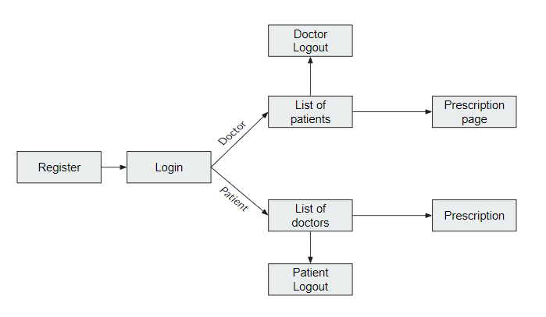
Workflow

Slide 3
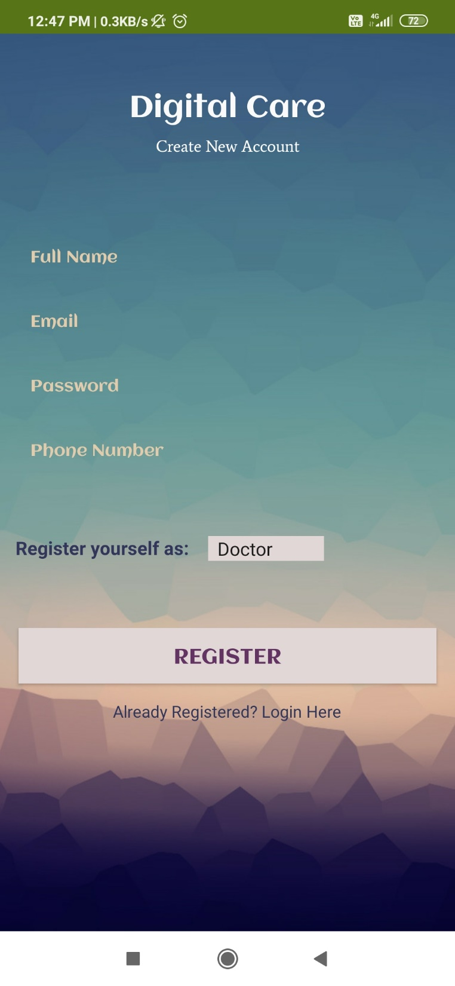
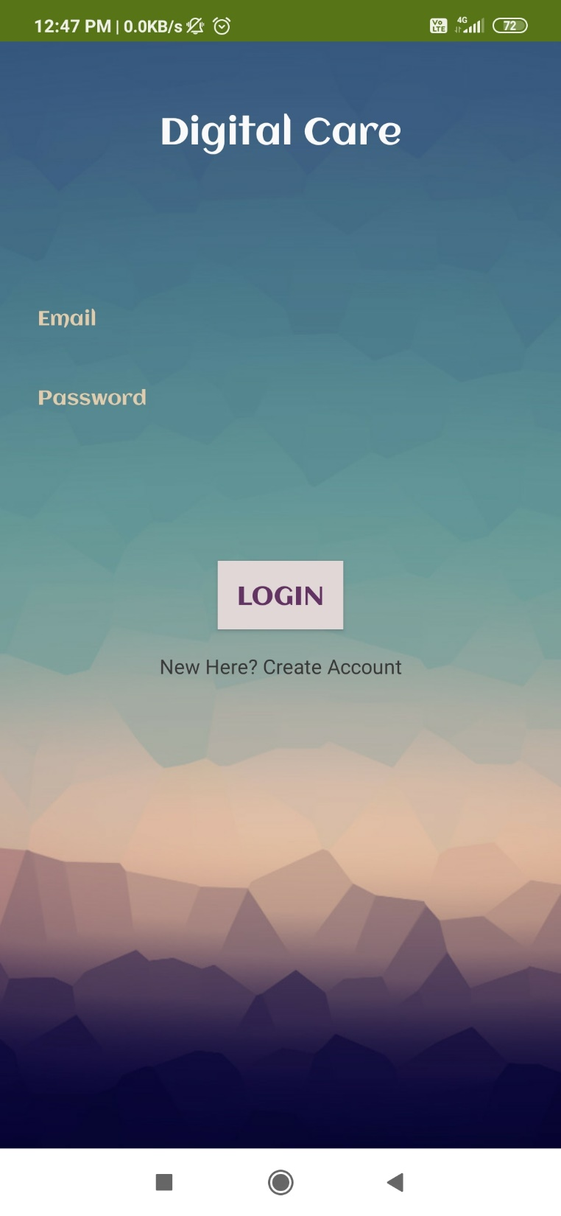
User registration & login

Slide 4
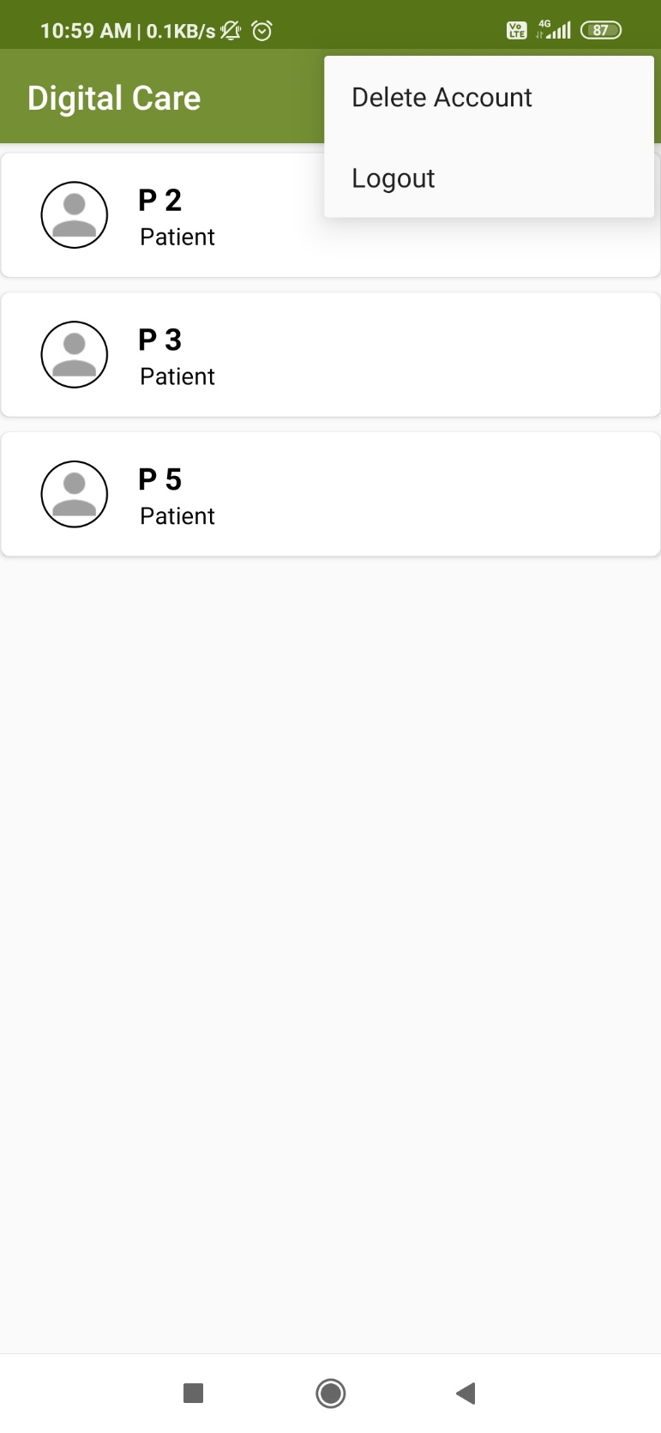
Doctor’s view

Slide 5
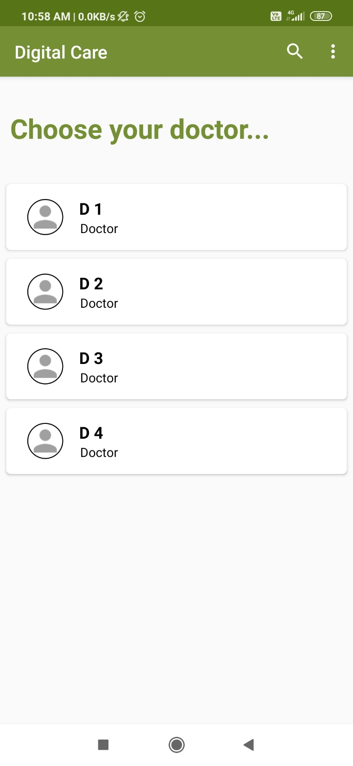
Patient’s view

Slide 6
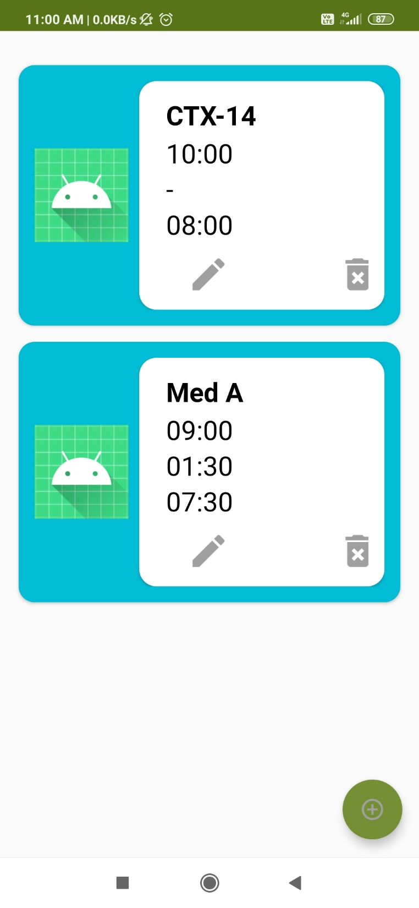
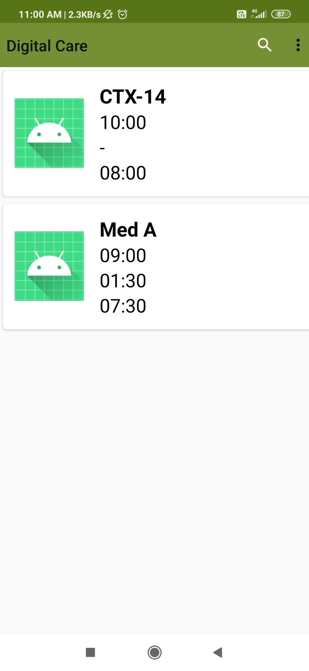
Prescription

